Slide 1
Twin Cities Gallery Crawl
Our last ever!

Slide 2
What Is a Gallery Crawl?
Raises funds for local charities
More than $7 million collected
See three local galleries for one price
Parties, signings, and prizes
Involves many local businesses
Draws attention to the arts district

Slide 3
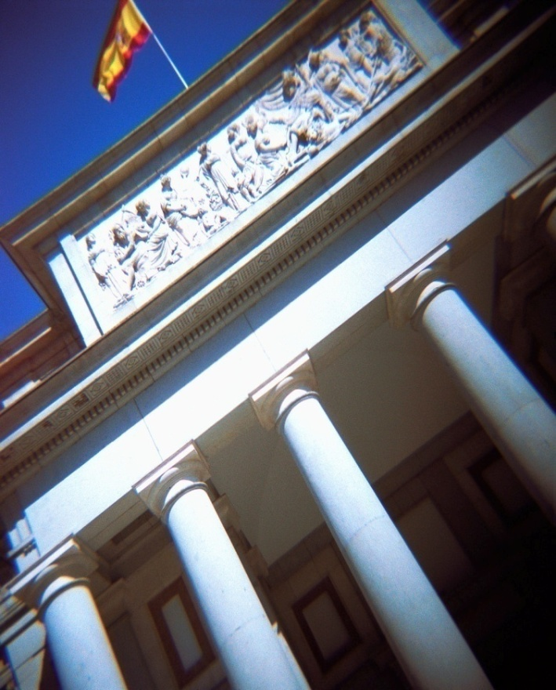
The Owens Museum
First stop on the tour
Oldest museum in the Twin Cities
State’s largest Art Deco collection
Local restaurants serving in the ballroom

Slide 4
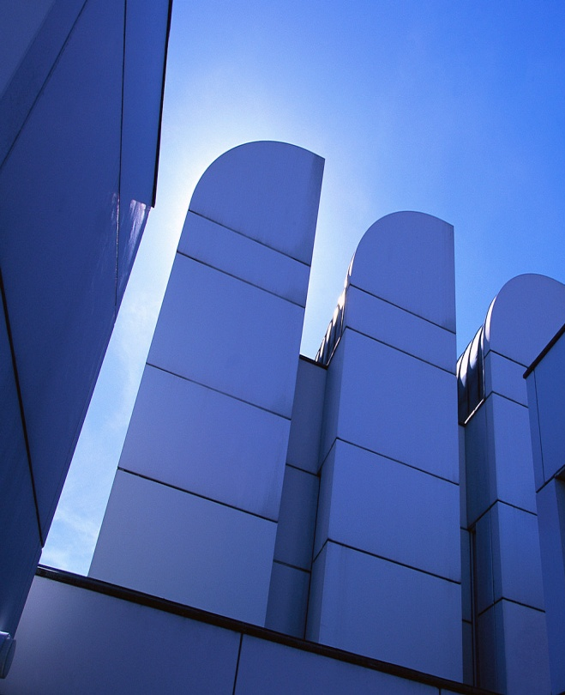
The Price Gallery
Largest collection of modern art in the state
Fine art auction
Appraisal seminar
Artist signing in the courtyard

Slide 5
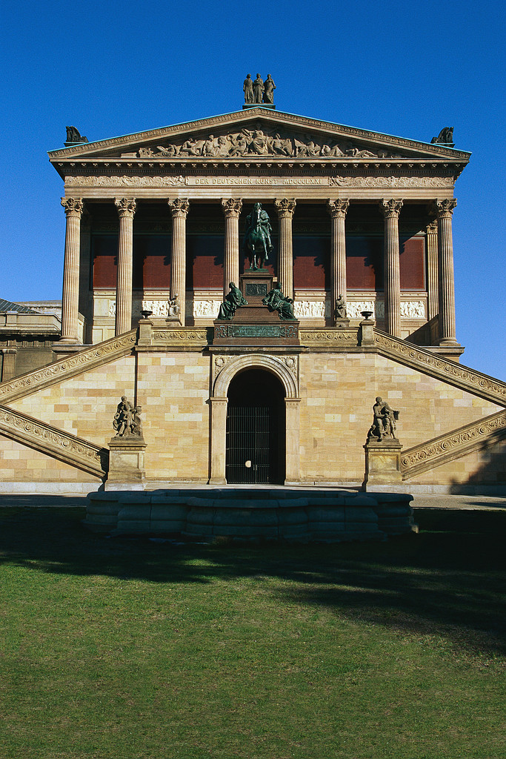
The Hart Museum
The crawl’s final stop
Superb collection of ancient art
Documentary screenings
Appraisals
Crawl’s End Party on the Pavilion

Slide 6
Participating Businesses
Graphic Design Institute
Coho Vineyard
Fourth Coffee
School of Fine Art
Northwind Traders
Alpine House
Z Bistro

Slide 7
For Information
Nicole Caron
Director
Graphic Design Institute
678 Dilworth Avenue
Twin Cities, MN 67890
404.555.0186
ncaron@graphicdesigninstitute.com

